Slide 1
Logistic Regression – Basic Relationships
SW388R7
Data Analysis & Computers II
Slide <number>
Logistic Regression
Describing Relationships
Classification Accuracy
Sample Problems

Slide 2
Logistic regression
SW388R7
Data Analysis & Computers II
Slide <number>
Logistic regression is used to analyze relationships between a dichotomous dependent variable and metric or dichotomous independent variables. (SPSS now supports Multinomial Logistic Regression that can be used with more than two groups, but our focus here is on binary logistic regression for two groups.)
Logistic regression combines the independent variables to estimate the probability that a particular event will occur, i.e. a subject will be a member of one of the groups defined by the dichotomous dependent variable. In SPSS, the model is always constructed to predict the group with higher numeric code. If responses are coded 1 for Yes and 2 for No, SPSS will predict membership in the No category. If responses are coded 1 for No and 2 for Yes, SPSS will predict membership in the Yes category. We will refer to the predicted event for a particular analysis as the modeled event.
This will create some awkward wording in our problems. Our only option for changing this is to recode the variable.

Slide 3
What logistic regression predicts
SW388R7
Data Analysis & Computers II
Slide <number>
The variate or value produced by logistic regression is a probability value between 0.0 and 1.0.
If the probability for group membership in the modeled category is above some cut point (the default is 0.50), the subject is predicted to be a member of the modeled group. If the probability is below the cut point, the subject is predicted to be a member of the other group.
For any given case, logistic regression computes the probability that a case with a particular set of values for the independent variable is a member of the modeled category.

Slide 4
Level of measurement requirements
SW388R7
Data Analysis & Computers II
Slide <number>
Logistic regression analysis requires that the dependent variable be dichotomous.
Logistic regression analysis requires that the independent variables be metric or dichotomous.
If an independent variable is nominal level and not dichotomous, the logistic regression procedure in SPSS has a option to dummy code the variable for you.
If an independent variable is ordinal, we will attach the usual caution.

Slide 5
Assumptions
SW388R7
Data Analysis & Computers II
Slide <number>
Logistic regression does not make any assumptions of normality, linearity, and homogeneity of variance for the independent variables.
Because it does not impose these requirements, it is preferred to discriminant analysis when the data does not satisfy these assumptions.

Slide 6
Sample size requirements
SW388R7
Data Analysis & Computers II
Slide <number>
The minimum number of cases per independent variable is 10, using a guideline provided by Hosmer and Lemeshow, authors of Applied Logistic Regression, one of the main resources for Logistic Regression.
For preferred case-to-variable ratios, we will use 20 to 1 for simultaneous and hierarchical logistic regression and 50 to 1 for stepwise logistic regression.

Slide 7
Methods for including variables
SW388R7
Data Analysis & Computers II
Slide <number>
There are three methods available for including variables in the regression equation:
  the simultaneous method in which all independents are included at the same time
  The hierarchical method in which control variables are entered in the analysis before the predictors whose effects we are primarily concerned with.
  The stepwise method (forward conditional in SPSS) in which variables are selected in the order in which they maximize the statistically significant contribution to the model.
For all methods, the contribution to the model is measures by model chi-square is a statistical measure of the fit between the dependent and independent variables, like R².

Slide 8
Computational method
SW388R7
Data Analysis & Computers II
Slide <number>
Multiple regression uses the least-squares method to find the coefficients for the independent variables in the regression equation, i.e. it computed coefficients that minimized the residuals for all cases.
Logistic regression uses maximum-likelihood estimation to compute the coefficients for the logistic regression equation. This method finds attempts to find coefficients that match the breakdown of cases on the dependent variable.
The overall measure of how will the model fits is given by the likelihood value, which is similar to the residual or error sum of squares value for multiple regression. A model that fits the data well will have a small likelihood value. A perfect model would have a likelihood value of zero.
Maximum-likelihood estimation is an interative procedure that successively tries works to get closer and closer to the correct answer. When SPSS reports the "iterations," it is telling us how may cycles it took to get the answer.

Slide 9
Overall test of relationship
SW388R7
Data Analysis & Computers II
Slide <number>
The overall test of relationship among the independent variables and groups defined by the dependent is based on the reduction in the likelihood values for a model which does not contain any independent variables and the model that contains the independent variables.
This difference in likelihood follows a chi-square distribution, and is referred to as the model chi-square.
The significance test for the model chi-square is our statistical evidence of the presence of a relationship between the dependent variable and the combination of the independent variables.

Slide 10
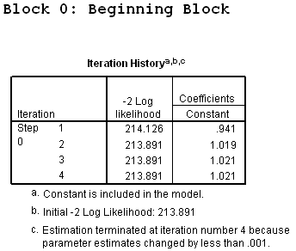
Beginning logistic regression model
SW388R7
Data Analysis & Computers II
Slide <number>
The SPSS output for logistic regression begins with output for a model that contains no independent variables. It labels this output "Block 0: Beginning Block" and (if we request the optional iteration history) reports the initial -2 Log Likelihood, which we can think of as a measure of the error associated trying to predict the dependent variable without using any information from the independent variables.
The initial -2 log likelihood is 213.891.
We will not routinely request the iteration history because it does not usually yield us additional useful information.

Slide 11
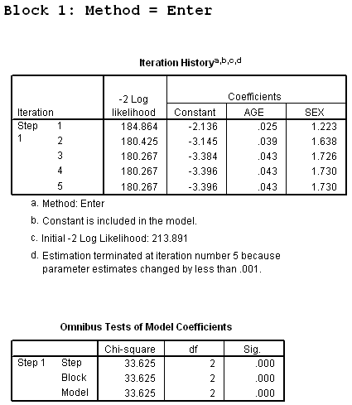
Ending logistic regression model
SW388R7
Data Analysis & Computers II
Slide <number>
After the independent variables are entered in Block 1, the -2 log likelihood is again measured (180.267 in this problem).
The difference between ending and beginning -2 log likelihood is the model chi-square that is used in the test of overall statistical significance.
In this problem, the model chi-square is 33.625 (213.891 – 180.267), which is statistically significant at p<0.001.
Model chi-square is 33.625, significant at p < 0.001.

Slide 12
Relationship of Individual Independent Variables and Dependent Variable
SW388R7
Data Analysis & Computers II
Slide <number>
There is a test of significance for the relationship between an individual independent variable and the dependent variable, a significance test of the Wald statistic .
The individual coefficients represent change in the probability of being a member of the modeled category. Individual coefficients are expressed in log units and are not directly interpretable. However, if the b coefficient is used as the power to which the base of the natural logarithm (2.71828) is raised, the result represents the change in the odds of the modeled event associated with a one-unit change in the independent variable.
If a coefficient is positive, its transformed log value will be greater than one, meaning that the modeled event is more likely to occur. If a coefficient is negative, its transformed log value will be less than one, and the odds of the event occurring decrease. A coefficient of zero (0) has a transformed log value of 1.0, meaning that this coefficient does not change the odds of the event one way or the other.

Slide 13
Numerical problems
SW388R7
Data Analysis & Computers II
Slide <number>
The maximum likelihood method used to calculate logistic regression is an iterative fitting process that attempts to cycle through repetitions to find an answer.
Sometimes, the method will break down and not be able to converge or find an answer.
Sometimes the method will produce wildly improbable results, reporting that a one-unit change in an independent variable increases the odds of the modeled event by hundreds of thousands or millions. These implausible results can be produced by multicollinearity, categories of predictors having no cases or zero cells, and complete separation whereby the two groups are perfectly separated by the scores on one or more independent variables.
The clue that we have numerical problems and should not interpret the results are standard errors for some independent variables that are larger than 2.0.

Slide 14
Strength of logistic regression relationship
SW388R7
Data Analysis & Computers II
Slide <number>
While logistic regression does compute correlation measures to estimate the strength of the relationship (pseudo R square measures, such as Nagelkerke's R²), these correlations measures do not really tell us much about the accuracy or errors associated with the model.
A more useful measure to assess the utility of a logistic regression model is classification accuracy, which compares predicted group membership based on the logistic model to the actual, known group membership, which is the value for the dependent variable.

Slide 15
Evaluating usefulness for logistic models
SW388R7
Data Analysis & Computers II
Slide <number>
The benchmark that we will use to characterize a logistic regression model as useful is a 25% improvement over the rate of accuracy achievable by chance alone.
Even if the independent variables had no relationship to the groups defined by the dependent variable, we would still expect to be correct in our predictions of group membership some percentage of the time. This is referred to as by chance accuracy.
The estimate of by chance accuracy that we will use is the proportional by chance accuracy rate, computed by summing the squared percentage of cases in each group.

Slide 16
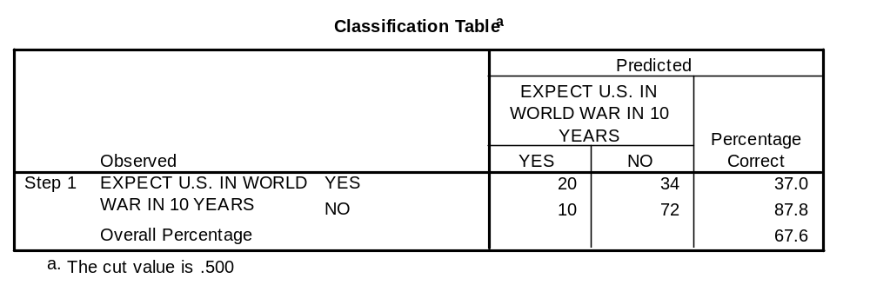
Comparing accuracy rates
SW388R7
Data Analysis & Computers II
Slide <number>
To characterize our model as useful, we compare the overall percentage accuracy rate produced by SPSS at the last step in which variables are entered to 25% more than the proportional by chance accuracy. (Note: SPSS does not compute a cross-validated accuracy rate for logistic regression.)
SPSS reports the overall accuracy rate in the footnotes to the table "Classification Table." The overall accuracy rate computed by SPSS was 67.6%.

Slide 17
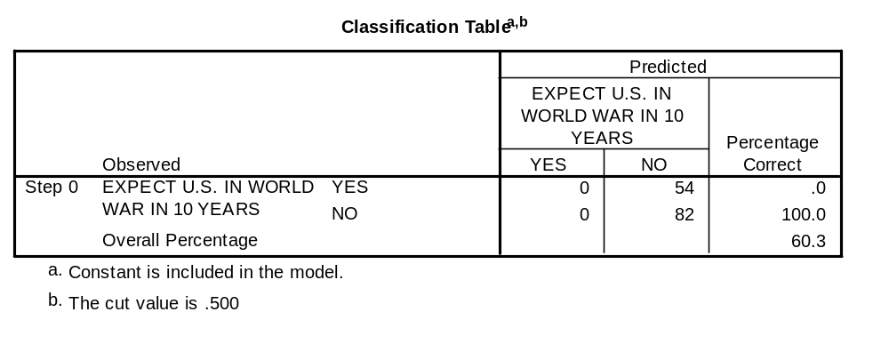
Computing by chance accuracy
SW388R7
Data Analysis & Computers II
Slide <number>
The number of cases in each group is found in the Classification Table at Step 0 (before any independent variables are included). The proportion of cases in the largest group is equal to the overall percentage (60.3%).
The proportional by chance accuracy rate was computed by calculating the proportion of cases for each group based on the number of cases in each group in the classification table at Step 0, and then squaring and summing the proportion of cases in each group (0.397² + 0.603² = 0.521).
The proportional by chance accuracy criteria is 65.2% (1.25 x 52.1% = 65.2%).

Slide 18
Problem 1
SW388R7
Data Analysis & Computers II
Slide <number>
In the dataset GSS2000.sav, is the following statement true, false, or an incorrect application of a statistic? Assume that there is no problem with missing data, outliers, or influential cases, and that the validation analysis will confirm the generalizability of the results. Use a level of significance of 0.05 for evaluating the statistical relationship.
The variables "age" [age], "sex" [sex], and "liberal or conservative political views" [polviews] were useful predictors for distinguishing between groups based on responses to "seen x-rated movie in last year" [xmovie]. These predictors differentiate survey respondents who have not seen an x-rated movie from survey respondents who have seen an x-rated movie.
Survey respondents who were older were more likely to have not seen an x-rated movie. A one unit increase in age increased the odds that survey respondents have not seen an x-rated movie by 3.9%. Survey respondents who were female were approximately six and three quarters times more likely to have not seen an x-rated movie. Survey respondents who were more conservative were more likely to have not seen an x-rated movie. A one unit increase in liberal or conservative political views increased the odds that survey respondents have not seen an x-rated movie by approximately one and a quarter times.
1. True
2. True with caution
3. False
4. Inappropriate application of a statistic

Slide 19
Dissecting problem 1 - 1
SW388R7
Data Analysis & Computers II
Slide <number>
In the dataset GSS2000.sav, is the following statement true, false, or an incorrect application of a statistic? Assume that there is no problem with missing data, outliers, or influential cases, and that the validation analysis will confirm the generalizability of the results. Use a level of significance of 0.05 for evaluating the statistical relationship.
The variables "age" [age], "sex" [sex], and "liberal or conservative political views" [polviews] were useful predictors for distinguishing between groups based on responses to "seen x-rated movie in last year" [xmovie]. These predictors differentiate survey respondents who have not seen an x-rated movie from survey respondents who have seen an x-rated movie.
Survey respondents who were older were more likely to have not seen an x-rated movie. A one unit increase in age increased the odds that survey respondents have not seen an x-rated movie by 3.9%. Survey respondents who were female were approximately six and three quarters times more likely to have not seen an x-rated movie. Survey respondents who were more conservative were more likely to have not seen an x-rated movie. A one unit increase in liberal or conservative political views increased the odds that survey respondents have not seen an x-rated movie by approximately one and a quarter times.
1. True
2. True with caution
3. False
4. Inappropriate application of a statistic
For these problems, we will assume that there is no problem with missing data, outliers, or influential cases, and that the validation analysis will confirm the generalizability of the results
In this problem, we are told to use 0.05 as alpha for the logistic regression.

Slide 20
Dissecting problem 1 - 2
SW388R7
Data Analysis & Computers II
Slide <number>
The variables listed first in the problem statement are the independent variables (IVs): "age" [age], "sex" [sex], and "liberal or conservative political views" [polviews].
In the dataset GSS2000.sav, is the following statement true, false, or an incorrect application of a statistic? Assume that there is no problem with missing data, outliers, or influential cases, and that the validation analysis will confirm the generalizability of the results. Use a level of significance of 0.05 for evaluating the statistical relationship.
The variables "age" [age], "sex" [sex], and "liberal or conservative political views" [polviews] were useful predictors for distinguishing between groups based on responses to "seen x-rated movie in last year" [xmovie]. These predictors differentiate survey respondents who have not seen an x-rated movie from survey respondents who have seen an x-rated movie.
Survey respondents who were older were more likely to have not seen an x-rated movie. A one unit increase in age increased the odds that survey respondents have not seen an x-rated movie by 3.9%. Survey respondents who were female were approximately six and three quarters times more likely to have not seen an x-rated movie. Survey respondents who were more conservative were more likely to have not seen an x-rated movie. A one unit increase in liberal or conservative political views increased the odds that survey respondents have not seen an x-rated movie by approximately one and a quarter times.
The variable used to define groups is the dependent variable (DV): "seen x-rated movie in last year" [xmovie].
When a problem states that a list of independent variables can distinguish among groups and does not identify control variable or an order of importance for the variables, we do a logistic regression entering all of the variables simultaneously.

Slide 21
Dissecting problem 1 - 3
SW388R7
Data Analysis & Computers II
Slide <number>
SPSS logistic regression models the relationship by computing the changes in the likelihood of falling in the category of the dependent variable which had the highest numerical code.
The responses to seeing an x-rated movie were coded:
1= Yes and 2 = No.
The SPSS output will model the changes in the likelihood of not seeing an x-rated movie because the code for No is 2.
In the dataset GSS2000.sav, is the following statement true, false, or an incorrect application of a statistic? Assume that there is no problem with missing data, outliers, or influential cases, and that the validation analysis will confirm the generalizability of the results. Use a level of significance of 0.05 for evaluating the statistical relationship.
The variables "age" [age], "sex" [sex], and "liberal or conservative political views" [polviews] were useful predictors for distinguishing between groups based on responses to "seen x-rated movie in last year" [xmovie]. These predictors differentiate survey respondents who have not seen an x-rated movie from survey respondents who have seen an x-rated movie.
Survey respondents who were older were more likely to have not seen an x-rated movie. A one unit increase in age increased the odds that survey respondents have not seen an x-rated movie by 3.9%. Survey respondents who were female were approximately six and three quarters times more likely to have not seen an x-rated movie. Survey respondents who were more conservative were more likely to have not seen an x-rated movie. A one unit increase in liberal or conservative political views increased the odds that survey respondents have not seen an x-rated movie by approximately one and a quarter times.
The statements of the specific relationships between independent variables and the dependent variable are all phrased in terms of impact on not seeing an x-rated movie.

Slide 22
Dissecting problem 1 - 4
SW388R7
Data Analysis & Computers II
Slide <number>
In the dataset GSS2000.sav, is the following statement true, false, or an incorrect application of a statistic? Assume that there is no problem with missing data, outliers, or influential cases, and that the validation analysis will confirm the generalizability of the results. Use a level of significance of 0.05 for evaluating the statistical relationship.
The variables "age" [age], "sex" [sex], and "liberal or conservative political views" [polviews] were useful predictors for distinguishing between groups based on responses to "seen x-rated movie in last year" [xmovie]. These predictors differentiate survey respondents who have not seen an x-rated movie from survey respondents who have seen an x-rated movie.
Survey respondents who were older were more likely to have not seen an x-rated movie. A one unit increase in age increased the odds that survey respondents have not seen an x-rated movie by 3.9%. Survey respondents who were female were approximately six and three quarters times more likely to have not seen an x-rated movie. Survey respondents who were more conservative were more likely to have not seen an x-rated movie. A one unit increase in liberal or conservative political views increased the odds that survey respondents have not seen an x-rated movie by approximately one and a quarter times.
1. True
2. True with caution
3. False
4. Inappropriate application of a statistic
The specific relationships for the independent variables listed in the problem indicate the direction of the relationship, increasing or decreasing the likelihood of falling in the modeled group, and the amount of change in the odds associated with a one-unit change in the independent variable.
In order for the logistic regression question to be true, the overall relationship must be statistically significant, there must be no evidence of a flawed numerical analysis, the classification accuracy rate must be substantially better than could be obtained by chance alone, and each significant relationship must be interpreted correctly.

Slide 23
LEVEL OF MEASUREMENT - 1
SW388R7
Data Analysis & Computers II
Slide <number>
In the dataset GSS2000.sav, is the following statement true, false, or an incorrect application of a statistic? Assume that there is no problem with missing data, outliers, or influential cases, and that the validation analysis will confirm the generalizability of the results. Use a level of significance of 0.05 for evaluating the statistical relationship.
The variables "age" [age], "sex" [sex], and "liberal or conservative political views" [polviews] were useful predictors for distinguishing between groups based on responses to "seen x-rated movie in last year" [xmovie]. These predictors differentiate survey respondents who have not seen an x-rated movie from survey respondents who have seen an x-rated movie.
Survey respondents who were older were more likely to have not seen an x-rated movie. A one unit increase in age increased the odds that survey respondents have not seen an x-rated movie by 3.9%. Survey respondents who were female were approximately six and three quarters times more likely to have not seen an x-rated movie. Survey respondents who were more conservative were more likely to have not seen an x-rated movie. A one unit increase in liberal or conservative political views increased the odds that survey respondents have not seen an x-rated movie by approximately one and a quarter times.
1. True
2. True with caution
3. False
4. Inappropriate application of a statistic
Logistic regression requires that the dependent variable be non-metric and the independent variables be metric or dichotomous. "seen x-rated movie in last year" [xmovie] is an dichotomous variable, which satisfies the level of measurement requirement.
It contains two categories: survey respondents who had seen an x-rated movie in the last year and survey respondents who had not seen an x-rated movie in the last year.

Slide 24
LEVEL OF MEASUREMENT - 2
SW388R7
Data Analysis & Computers II
Slide <number>
"Age" [age] is an interval level variable, which satisfies the level of measurement requirements for logistic regression analysis.
"Sex" [sex] is a dichotomous or dummy-coded nominal variable which may be included in logistic regression.
In the dataset GSS2000.sav, is the following statement true, false, or an incorrect application of a statistic? Assume that there is no problem with missing data, outliers, or influential cases, and that the validation analysis will confirm the generalizability of the results. Use a level of significance of 0.05 for evaluating the statistical relationship.
The variables "age" [age], "sex" [sex], and "liberal or conservative political views" [polviews] were useful predictors for distinguishing between groups based on responses to "seen x-rated movie in last year" [xmovie]. These predictors differentiate survey respondents who have not seen an x-rated movie from survey respondents who have seen an x-rated movie.
Survey respondents who were older were more likely to have not seen an x-rated movie. A one unit increase in age increased the odds that survey respondents have not seen an x-rated movie by 3.9%. Survey respondents who were female were approximately six and three quarters times more likely to have not seen an x-rated movie. Survey respondents who were more conservative were more likely to have not seen an x-rated movie. A one unit increase in liberal or conservative political views increased the odds that survey respondents have not seen an x-rated movie by approximately one and a quarter times.
1. True
2. True with caution
3. False
4. Inappropriate application of a statistic
"Liberal or conservative political views" [polviews] is an ordinal level variable. If we follow the convention of treating ordinal level variables as metric variables, the level of measurement requirement for logistic regression analysis is satisfied. Since some data analysts do not agree with this convention, a note of caution should be included in our interpretation.

Slide 25
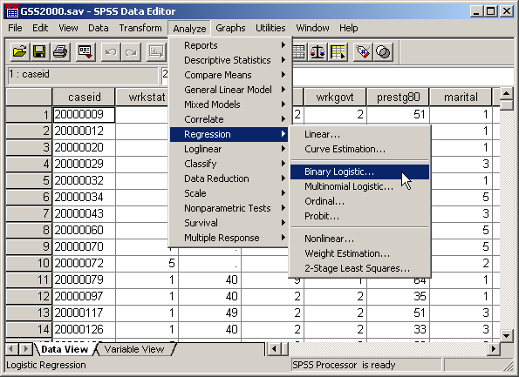
Request simultaneous logistic regression
SW388R7
Data Analysis & Computers II
Slide <number>
Select the Regression | Binary Logistic… command from the Analyze menu.

Slide 26
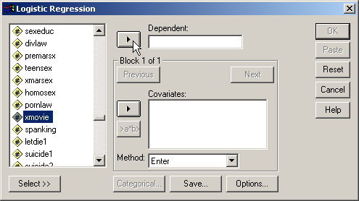
Selecting the dependent variable
SW388R7
Data Analysis & Computers II
Slide <number>
First, highlight the dependent variable xmovie in the list of variables.
Second, click on the right arrow button to move the dependent variable to the Dependent text box.

Slide 27
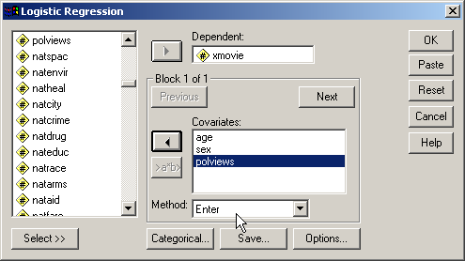
Selecting the independent variables
SW388R7
Data Analysis & Computers II
Slide <number>
Move the independent variables listed in the problem to the Covariates list box.

Slide 28
Specifying the method for including variables
SW388R7
Data Analysis & Computers II
Slide <number>
SPSS provides us with two methods for including variables: to enter all of the independent variables at one time, and a stepwise method for selecting variables using a statistical test to determine the order in which variables are included.
SPSS also supports the specification of "Blocks" of variables for testing hierarchical models.
Since the problem states that there is a relationship without requesting the best predictors, we specify Enter as the method for including variables.

Slide 29
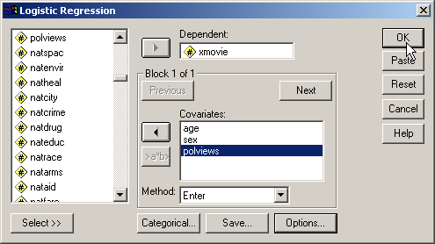
Completing the logistic regression request
SW388R7
Data Analysis & Computers II
Slide <number>
Click on the OK button to request the output for the logistic regression.
The logistic procedure supports the selection of subsets of cases, automatic recoding of nominal variables, saving diagnostic statistics like standardized residuals and Cook's distance, and options for additional statistics. However, none of these are needed for this analysis.

Slide 30
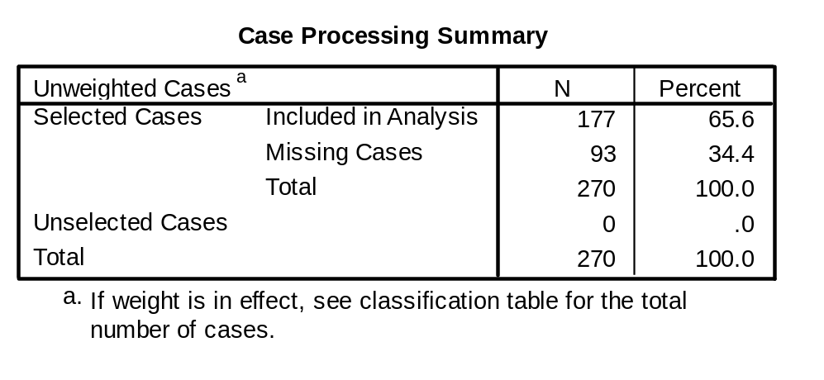
Sample size – ratio of cases to variables
SW388R7
Data Analysis & Computers II
Slide <number>
The minimum ratio of valid cases to independent variables for logistic regression is 10 to 1, with a preferred ratio of 20 to 1. In this analysis, there are 177 valid cases and 3 independent variables. The ratio of cases to independent variables is 59.0 to 1, which satisfies the minimum requirement. In addition, the ratio of 59.0 to 1 satisfies the preferred ratio of 20 to 1.

Slide 31
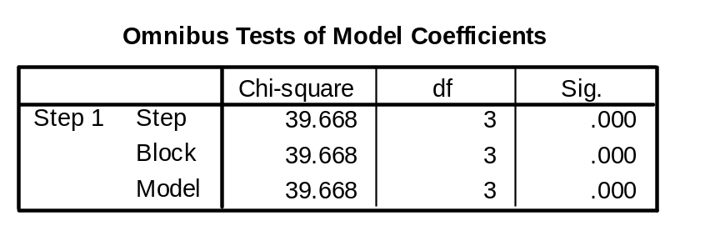
OVERALL RELATIONSHIP BETWEEN INDEPENDENT AND DEPENDENT VARIABLES
SW388R7
Data Analysis & Computers II
Slide <number>
The presence of a relationship between the dependent variable and combination of independent variables is based on the statistical significance of the model chi-square at step 1 after the independent variables have been added to the analysis.
In this analysis, the probability of the model chi-square (39.668) was <0.001, less than or equal to the level of significance of 0.05. The null hypothesis that there is no difference between the model with only a constant and the model with independent variables was rejected. The existence of a relationship between the independent variables and the dependent variable was supported.

Slide 32
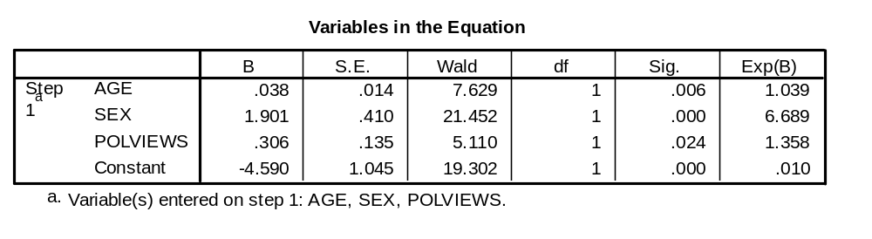
NUMERICAL PROBLEMS
SW388R7
Data Analysis & Computers II
Slide <number>
Multicollinearity in the logistic regression solution is detected by examining the standard errors for the b coefficients. A standard error larger than 2.0 indicates numerical problems, such as multicollinearity among the independent variables, zero cells for a dummy-coded independent variable because all of the subjects have the same value for the variable, and 'complete separation' whereby the two groups in the dependent event variable can be perfectly separated by scores on one of the independent variables. Analyses that indicate numerical problems should not be interpreted.
None of the independent variables in this analysis had a standard error larger than 2.0. (The check for standard errors larger than 2.0 does not include the standard error for the Constant.)

Slide 33
RELATIONSHIP OF INDIVIDUAL INDEPENDENT VARIABLES TO DEPENDENT VARIABLE - 1
SW388R7
Data Analysis & Computers II
Slide <number>
The probability of the Wald statistic for the variable age was 0.006, less than or equal to the level of significance of 0.05. The null hypothesis that the b coefficient for age was equal to zero was rejected. This supports the relationship that "survey respondents who were older were more likely to have not seen an x-rated movie."
The value of Exp(B) was 1.039 which implies that a one unit increase in age increased the odds that survey respondents have not seen an x-rated movie by 3.9%. This confirms the statement of the amount of change in the likelihood of belonging to the modeled group of the dependent variable associated with a one unit change in the independent variable, age.

Slide 34
RELATIONSHIP OF INDIVIDUAL INDEPENDENT VARIABLES TO DEPENDENT VARIABLE - 2
SW388R7
Data Analysis & Computers II
Slide <number>
The probability of the Wald statistic for the variable sex was <0.001, less than or equal to the level of significance of 0.05. The null hypothesis that the b coefficient for sex was equal to zero was rejected. This supports the relationship that "survey respondents who were female were approximately six and three quarters times more likely to have not seen an x-rated movie."
The value of Exp(B) was 6.689 which implies that a one unit increase in sex increased the odds by approximately six and three quarters times that survey respondents have not seen an x-rated movie.

Slide 35
RELATIONSHIP OF INDIVIDUAL INDEPENDENT VARIABLES TO DEPENDENT VARIABLE - 3
SW388R7
Data Analysis & Computers II
Slide <number>
The probability of the Wald statistic for the variable liberal or conservative political views was 0.024, less than or equal to the level of significance of 0.05. The null hypothesis that the b coefficient for liberal or conservative political views was equal to zero was rejected. This supports the relationship that "survey respondents who were more conservative were more likely to have not seen an x-rated movie." Liberal or conservative political views is an ordinal variable that is coded so that higher numeric values are associated with survey respondents who were more conservative.
The value of Exp(B) was 1.358 which implies that a one unit increase in liberal or conservative political views increased the odds that survey respondents have not seen an x-rated movie by approximately one and a quarter times.

Slide 36
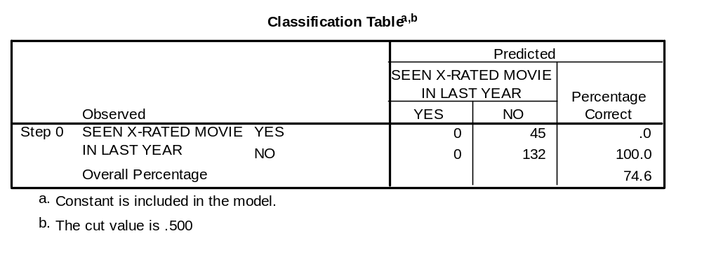
CLASSIFICATION USING THE LOGISTIC REGRESSION MODEL: by chance accuracy rate
SW388R7
Data Analysis & Computers II
Slide <number>
The independent variables could be characterized as useful predictors distinguishing survey respondents who have not seen an x-rated movie from survey respondents who have seen an x-rated movie if the classification accuracy rate was substantially higher than the accuracy attainable by chance alone. Operationally, the classification accuracy rate should be 25% or more higher than the proportional by chance accuracy rate.
The proportional by chance accuracy rate was computed by first calculating the proportion of cases for each group based on the number of cases in each group in the classification table at Step 0. The proportion in the "YES" group is 45/177 = 0.254. The proportion in the "No" group is 132/177 = 0.746.
Then, we square and sum the proportion of cases in each group (0.254² + 0.746² = 0.621). 0.621 is the proportional by chance accuracy rate.

Slide 37
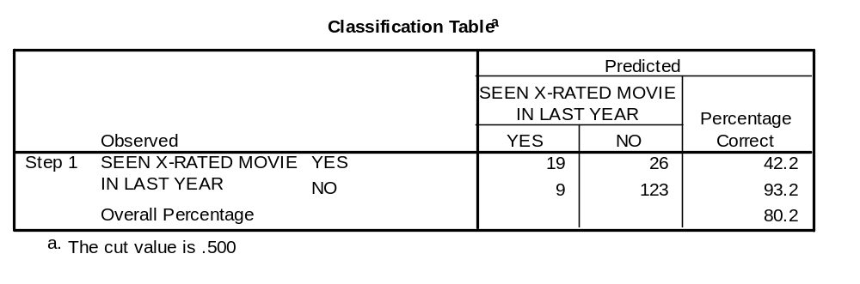
CLASSIFICATION USING THE LOGISTIC REGRESSION MODEL: criteria for classification accuracy
SW388R7
Data Analysis & Computers II
Slide <number>
The accuracy rate computed by SPSS was 80.2% which was greater than or equal to the proportional by chance accuracy criteria of 77.6% (1.25 x 62.1% = 77.6%).
The criteria for classification accuracy is satisfied.

Slide 38
Answering the question in problem 1 - 1
SW388R7
Data Analysis & Computers II
Slide <number>
In the dataset GSS2000.sav, is the following statement true, false, or an incorrect application of a statistic? Assume that there is no problem with missing data, outliers, or influential cases, and that the validation analysis will confirm the generalizability of the results. Use a level of significance of 0.05 for evaluating the statistical relationship.
The variables "age" [age], "sex" [sex], and "liberal or conservative political views" [polviews] were useful predictors for distinguishing between groups based on responses to "seen x-rated movie in last year" [xmovie]. These predictors differentiate survey respondents who have not seen an x-rated movie from survey respondents who have seen an x-rated movie.
Survey respondents who were older were more likely to have not seen an x-rated movie. A one unit increase in age increased the odds that survey respondents have not seen an x-rated movie by 3.9%. Survey respondents who were female were approximately six and three quarters times more likely to have not seen an x-rated movie. Survey respondents who were more conservative were more likely to have not seen an x-rated movie. A one unit increase in liberal or conservative political views increased the odds that survey respondents have not seen an x-rated movie by approximately one and a quarter times.
We found a statistically significant overall relationship between the combination of independent variables and the dependent variable.
There was no evidence of numerical problems in the solution.
Moreover, the classification accuracy surpassed the proportional by chance accuracy criteria, supporting the utility of the model.

Slide 39
Answering the question in problem 1 - 2
SW388R7
Data Analysis & Computers II
Slide <number>
In the dataset GSS2000.sav, is the following statement true, false, or an incorrect application of a statistic? Assume that there is no problem with missing data, outliers, or influential cases, and that the validation analysis will confirm the generalizability of the results. Use a level of significance of 0.05 for evaluating the statistical relationship.
The variables "age" [age], "sex" [sex], and "liberal or conservative political views" [polviews] were useful predictors for distinguishing between groups based on responses to "seen x-rated movie in last year" [xmovie]. These predictors differentiate survey respondents who have not seen an x-rated movie from survey respondents who have seen an x-rated movie.
Survey respondents who were older were more likely to have not seen an x-rated movie. A one unit increase in age increased the odds that survey respondents have not seen an x-rated movie by 3.9%. Survey respondents who were female were approximately six and three quarters times more likely to have not seen an x-rated movie. Survey respondents who were more conservative were more likely to have not seen an x-rated movie. A one unit increase in liberal or conservative political views increased the odds that survey respondents have not seen an x-rated movie by approximately one and a quarter times.
1. True
2. True with caution
3. False
4. Inappropriate application of a statistic
We verified that each statement about the relationship between an independent variable and the dependent variable was correct in both direction of the relationship and the change in likelihood associated with a one-unit change of the independent variable.
The answer to the question is true with caution.
A caution is added because of the inclusion of ordinal level variables.

Slide 40
Problem 2
SW388R7
Data Analysis & Computers II
Slide <number>
In the dataset GSS2000.sav, is the following statement true, false, or an incorrect application of a statistic? Assume that there is no problem with missing data, outliers, or influential cases, and that the validation analysis will confirm the generalizability of the results. Use a level of significance of 0.05 for evaluating the statistical relationship.
After controlling for the effect of the variable "sex" [sex] on "should marijuana be made legal" [grass], the variable "general happiness" [happy] and "confidence in the executive branch of the federal government" [confed] were useful predictors for distinguishing between groups based on responses to "should marijuana be made legal" [grass]. These predictors differentiate survey respondents who have been less supportive that the use of marijuana should be made legal from survey respondents who have been more supportive that the use of marijuana should be made legal.
Survey respondents who were less happy overall were less likely to have been less supportive that the use of marijuana should be made legal. A one unit increase in general happiness decreased the odds that survey respondents have been less supportive that the use of marijuana should be made legal by 66.9%. Survey respondents who had less confidence in the executive branch of the federal government were less likely to have been less supportive that the use of marijuana should be made legal. A one unit increase in confidence in the executive branch of the federal government decreased the odds that survey respondents have been less supportive that the use of marijuana should be made legal by 42.8%.
1. True
2. True with caution
3. False
4. Inappropriate application of a statistic

Slide 41
Dissecting problem 2 - 1
SW388R7
Data Analysis & Computers II
Slide <number>
In the dataset GSS2000.sav, is the following statement true, false, or an incorrect application of a statistic? Assume that there is no problem with missing data, outliers, or influential cases, and that the validation analysis will confirm the generalizability of the results. Use a level of significance of 0.05 for evaluating the statistical relationship.
After controlling for the effect of the variable "sex" [sex] on "should marijuana be made legal" [grass], the variable "general happiness" [happy] and "confidence in the executive branch of the federal government" [confed] were useful predictors for distinguishing between groups based on responses to "should marijuana be made legal" [grass]. These predictors differentiate survey respondents who have been less supportive that the use of marijuana should be made legal from survey respondents who have been more supportive that the use of marijuana should be made legal.
Survey respondents who were less happy overall were less likely to have been less supportive that the use of marijuana should be made legal. A one unit increase in general happiness decreased the odds that survey respondents have been less supportive that the use of marijuana should be made legal by 66.9%. Survey respondents who had less confidence in the executive branch of the federal government were less likely to have been less supportive that the use of marijuana should be made legal. A one unit increase in confidence in the executive branch of the federal government decreased the odds that survey respondents have been less supportive that the use of marijuana should be made legal by 42.8%.
1. True
2. True with caution
3. False
4. Inappropriate application of a statistic
For these problems, we will assume that there is no problem with missing data, outliers, or influential cases, and that the validation analysis will confirm the generalizability of the results
In this problem, we are told to use 0.05 as alpha for the logistic regression.

Slide 42
Dissecting problem 2 - 2
SW388R7
Data Analysis & Computers II
Slide <number>
The variables listed first in the problem statement are the independent variables (IVs): "sex" [sex] , "general happiness" [happy], and "confidence in the executive branch of the federal government" [confed].
Sex is a control variable and general happiness and confidence in the executive branchy are predictors.
In the dataset GSS2000.sav, is the following statement true, false, or an incorrect application of a statistic? Assume that there is no problem with missing data, outliers, or influential cases, and that the validation analysis will confirm the generalizability of the results. Use a level of significance of 0.05 for evaluating the statistical relationship.
After controlling for the effect of the variable "sex" [sex] on "should marijuana be made legal" [grass], the variable "general happiness" [happy] and "confidence in the executive branch of the federal government" [confed] were useful predictors for distinguishing between groups based on responses to "should marijuana be made legal" [grass]. These predictors differentiate survey respondents who have been less supportive that the use of marijuana should be made legal from survey respondents who have been more supportive that the use of marijuana should be made legal.
Survey respondents who were less happy overall were less likely to have been less supportive that the use of marijuana should be made legal. A one unit increase in general happiness decreased the odds that survey respondents have been less supportive that the use of marijuana should be made legal by 66.9%. Survey respondents who had less confidence in the executive branch of the federal government were less likely to have been less supportive that the use of marijuana should be made legal. A one unit increase in confidence in the executive branch of the federal government decreased the odds that survey respondents have been less supportive that the use of marijuana should be made legal by 42.8%.
The variable used to define groups is the dependent variable (DV): "should marijuana be made legal" [grass].
When a problem identifies control variables, we do a hierarchical logistic regression entering the variables in SPSS blocks.

Slide 43
Dissecting problem 2 - 3
SW388R7
Data Analysis & Computers II
Slide <number>
SPSS logistic regression models the relationship by computing the changes in the likelihood of falling in the category of the dependent variable which had the highest numerical code.
The responses to seeing an x-rated movie were coded:
1= Legal and 2 = Not Legal.
The SPSS output will model the changes in the likelihood of being less supportive of legalizing marijuana because 2 corresponds to not legalizing marijuana.
In the dataset GSS2000.sav, is the following statement true, false, or an incorrect application of a statistic? Assume that there is no problem with missing data, outliers, or influential cases, and that the validation analysis will confirm the generalizability of the results. Use a level of significance of 0.05 for evaluating the statistical relationship.
After controlling for the effect of the variable "sex" [sex] on "should marijuana be made legal" [grass], the variable "general happiness" [happy] and "confidence in the executive branch of the federal government" [confed] were useful predictors for distinguishing between groups based on responses to "should marijuana be made legal" [grass]. These predictors differentiate survey respondents who have been less supportive that the use of marijuana should be made legal from survey respondents who have been more supportive that the use of marijuana should be made legal.
Survey respondents who were less happy overall were less likely to have been less supportive that the use of marijuana should be made legal. A one unit increase in general happiness decreased the odds that survey respondents have been less supportive that the use of marijuana should be made legal by 66.9%. Survey respondents who had less confidence in the executive branch of the federal government were less likely to have been less supportive that the use of marijuana should be made legal. A one unit increase in confidence in the executive branch of the federal government decreased the odds that survey respondents have been less supportive that the use of marijuana should be made legal by 42.8%.
The statements of the specific relationships between independent variables and the dependent variable are all phrased in terms of impact on being less supportive of legalizing marijuana.

Slide 44
Dissecting problem 2 - 4
SW388R7
Data Analysis & Computers II
Slide <number>
In the dataset GSS2000.sav, is the following statement true, false, or an incorrect application of a statistic? Assume that there is no problem with missing data, outliers, or influential cases, and that the validation analysis will confirm the generalizability of the results. Use a level of significance of 0.05 for evaluating the statistical relationship.
After controlling for the effect of the variable "sex" [sex] on "should marijuana be made legal" [grass], the variable "general happiness" [happy] and "confidence in the executive branch of the federal government" [confed] were useful predictors for distinguishing between groups based on responses to "should marijuana be made legal" [grass]. These predictors differentiate survey respondents who have been less supportive that the use of marijuana should be made legal from survey respondents who have been more supportive that the use of marijuana should be made legal.
Survey respondents who were less happy overall were less likely to have been less supportive that the use of marijuana should be made legal. A one unit increase in general happiness decreased the odds that survey respondents have been less supportive that the use of marijuana should be made legal by 66.9%. Survey respondents who had less confidence in the executive branch of the federal government were less likely to have been less supportive that the use of marijuana should be made legal. A one unit increase in confidence in the executive branch of the federal government decreased the odds that survey respondents have been less supportive that the use of marijuana should be made legal by 42.8%.
1. True
2. True with caution
3. False
4. Inappropriate application of a statistic
The specific relationships for the independent variables listed in the problem indicate the direction of the relationship, increasing or decreasing the likelihood of falling in the modeled group, and the amount of change in the odds associated with a one-unit change in the independent variable.
In order for the logistic regression question to be true, the relationship between the predictors and the dependent variable must be statistically significant after entering the control variables in a previous stage, there must be no evidence of a flawed numerical analysis, the classification accuracy rate must be substantially better than could be obtained by chance alone, and each significant relationship must be interpreted correctly.

Slide 45
LEVEL OF MEASUREMENT - 1
SW388R7
Data Analysis & Computers II
Slide <number>
In the dataset GSS2000.sav, is the following statement true, false, or an incorrect application of a statistic? Assume that there is no problem with missing data, outliers, or influential cases, and that the validation analysis will confirm the generalizability of the results. Use a level of significance of 0.05 for evaluating the statistical relationship.
After controlling for the effect of the variable "sex" [sex] on "should marijuana be made legal" [grass], the variable "general happiness" [happy] and "confidence in the executive branch of the federal government" [confed] were useful predictors for distinguishing between groups based on responses to "should marijuana be made legal" [grass]. These predictors differentiate survey respondents who have been less supportive that the use of marijuana should be made legal from survey respondents who have been more supportive that the use of marijuana should be made legal.
Survey respondents who were less happy overall were less likely to have been less supportive that the use of marijuana should be made legal. A one unit increase in general happiness decreased the odds that survey respondents have been less supportive that the use of marijuana should be made legal by 66.9%. Survey respondents who had less confidence in the executive branch of the federal government were less likely to have been less supportive that the use of marijuana should be made legal. A one unit increase in confidence in the executive branch of the federal government decreased the odds that survey respondents have been less supportive that the use of marijuana should be made legal by 42.8%.
1. True
2. True with caution
3. False
4. Inappropriate application of a statistic
Logistic regression analysis requires that the dependent variable be dichotomous and the independent variables be metric or dichotomous. "Should marijuana be made legal" [grass] is a dichotomous variable, which satisfies the level of measurement requirement for the dependent variable.
It contains two categories:
survey respondents who have been less supportive that the use of marijuana should be made legal
survey respondents who have been more supportive that the use of marijuana should be made legal

Slide 46
LEVEL OF MEASUREMENT - 2
SW388R7
Data Analysis & Computers II
Slide <number>
"Sex" [sex] is a dichotomous or dummy-coded nominal variable which may be included in logistic regression analysis.
In the dataset GSS2000.sav, is the following statement true, false, or an incorrect application of a statistic? Assume that there is no problem with missing data, outliers, or influential cases, and that the validation analysis will confirm the generalizability of the results. Use a level of significance of 0.05 for evaluating the statistical relationship.
After controlling for the effect of the variable "sex" [sex] on "should marijuana be made legal" [grass], the variable "general happiness" [happy] and "confidence in the executive branch of the federal government" [confed] were useful predictors for distinguishing between groups based on responses to "should marijuana be made legal" [grass]. These predictors differentiate survey respondents who have been less supportive that the use of marijuana should be made legal from survey respondents who have been more supportive that the use of marijuana should be made legal.
Survey respondents who were less happy overall were less likely to have been less supportive that the use of marijuana should be made legal. A one unit increase in general happiness decreased the odds that survey respondents have been less supportive that the use of marijuana should be made legal by 66.9%. Survey respondents who had less confidence in the executive branch of the federal government were less likely to have been less supportive that the use of marijuana should be made legal. A one unit increase in confidence in the executive branch of the federal government decreased the odds that survey respondents have been less supportive that the use of marijuana should be made legal by 42.8%.
"General happiness" [happy] and "confidence in the executive branch of the federal government" [confed] are ordinal level variables. If we follow the convention of treating ordinal level variables as metric variables, the level of measurement requirement for logistic regression analysis is satisfied. Since some data analysts do not agree with this convention, a note of caution should be included in our interpretation.

Slide 47
Request hierarchical logistic regression
SW388R7
Data Analysis & Computers II
Slide <number>
Select the Regression | Binary Logistic… command from the Analyze menu.

Slide 48
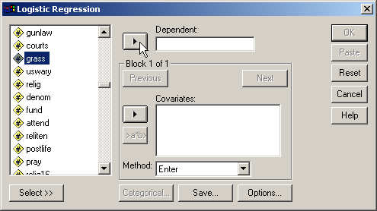
Selecting the dependent variable
SW388R7
Data Analysis & Computers II
Slide <number>
First, highlight the dependent variable grass in the list of variables.
Second, click on the right arrow button to move the dependent variable to the Dependent text box.

Slide 49
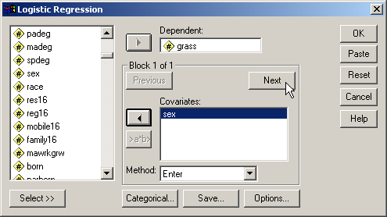
Selecting the control independent variables
SW388R7
Data Analysis & Computers II
Slide <number>
Second, click on the Next button to add the new block that will contain the predictors.
First, move the control independent variable, sex, listed in the problem to the Covariates list box.

Slide 50
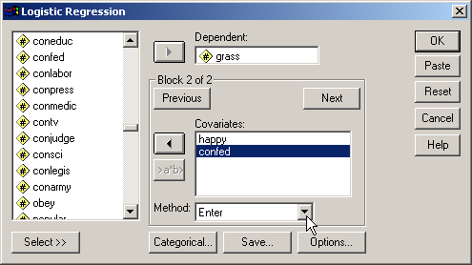
Adding the predictor independent variables
SW388R7
Data Analysis & Computers II
Slide <number>
First, move the predictors to the Covariates list box.

Slide 51
Specifying the method for including variables
SW388R7
Data Analysis & Computers II
Slide <number>
In our hierarchical regression, we will specify that all of the variables in each block be entered simultaneously when the block is entered.

Slide 52
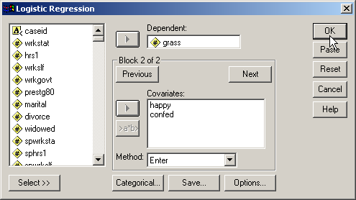
Completing the logistic regression request
SW388R7
Data Analysis & Computers II
Slide <number>
Click on the OK button to request the output for the logistic regression.
The logistic procedure supports the selection of subsets of cases, automatic recoding of nominal variables, saving diagnostic statistics like standardized residuals and Cook's distance, and options for additional statistics. However, none of these are needed for this analysis.

Slide 53

Sample size – ratio of cases to variables
SW388R7
Data Analysis & Computers II
Slide <number>
The minimum ratio of valid cases to independent variables for logistic regression is 10 to 1, with a preferred ratio of 20 to 1. In this analysis, there are 163 valid cases and 3 independent variables. The ratio of cases to independent variables is 54.33 to 1, which satisfies the minimum requirement. In addition, the ratio of 54.33 to 1 satisfies the preferred ratio of 20 to 1.

Slide 54
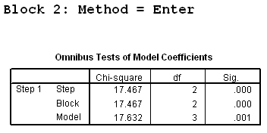
OVERALL RELATIONSHIP BETWEEN INDEPENDENT AND DEPENDENT VARIABLES
SW388R7
Data Analysis & Computers II
Slide <number>
In a hierarchical logistic regression, the presence of a relationship between the dependent variable and combination of independent variables entered after the control variables have been included is based on the statistical significance of the block chi-square for the second block of variables in which the predictor independent variables are included.
In this analysis, the probability of the block chi-square (17.467) was <0.001, less than or equal to the level of significance of 0.05. The null hypothesis that there is no difference between the model with only a constant and the control variables versus the model with the predictor independent variables was rejected. The contribution of the relationship between the predictor independent variables and the dependent variable was supported.

Slide 55
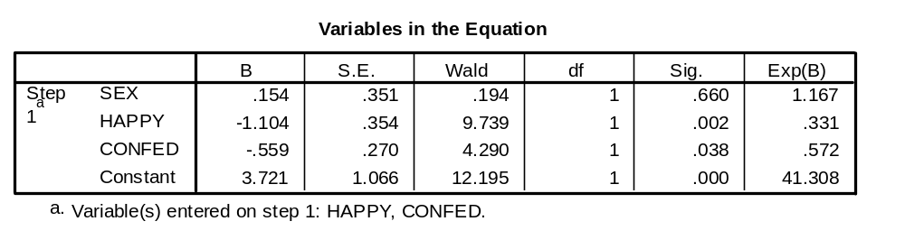
NUMERICAL PROBLEMS
SW388R7
Data Analysis & Computers II
Slide <number>
Multicollinearity in the logistic regression solution is detected by examining the standard errors for the b coefficients. A standard error larger than 2.0 indicates numerical problems, such as multicollinearity among the independent variables, zero cells for a dummy-coded independent variable because all of the subjects have the same value for the variable, and 'complete separation' whereby the two groups in the dependent event variable can be perfectly separated by scores on one of the independent variables. Analyses that indicate numerical problems should not be interpreted.
None of the independent variables in this analysis had a standard error larger than 2.0. (The check for standard errors larger than 2.0 does not include the standard error for the Constant.)

Slide 56

RELATIONSHIP OF INDIVIDUAL INDEPENDENT VARIABLES TO DEPENDENT VARIABLE - 1
SW388R7
Data Analysis & Computers II
Slide <number>
The probability of the Wald statistic for the variable general happiness was 0.002, less than or equal to the level of significance of 0.05. The null hypothesis that the b coefficient for general happiness was equal to zero was rejected. This supports the relationship that "survey respondents who were less happy overall were less likely to have been less supportive that the use of marijuana should be made legal." General happiness is an ordinal variable that is coded so that lower numeric values are associated with survey respondents who were happier overall.
The value of Exp(B) was 0.331 which implies that a one unit increase in general happiness decreased the odds that survey respondents have been less supportive that the use of marijuana should be made legal by 66.9%.

Slide 57
RELATIONSHIP OF INDIVIDUAL INDEPENDENT VARIABLES TO DEPENDENT VARIABLE - 2
SW388R7
Data Analysis & Computers II
Slide <number>
The probability of the Wald statistic for the variable confidence in the executive branch of the federal government was 0.038, less than or equal to the level of significance of 0.05. The null hypothesis that the b coefficient for confidence in the executive branch of the federal government was equal to zero was rejected. This supports the relationship that "survey respondents who had less confidence in the executive branch of the federal government were less likely to have been less supportive that the use of marijuana should be made legal." Confidence in the executive branch of the federal government is an ordinal variable that is coded so that lower numeric values are associated with survey respondents who had more confidence in the executive branch of the federal government.
The value of Exp(B) was 0.572 which implies that a one unit increase in confidence in the executive branch of the federal government decreased the odds that survey respondents have been less supportive that the use of marijuana should be made legal by 42.8%.

Slide 58
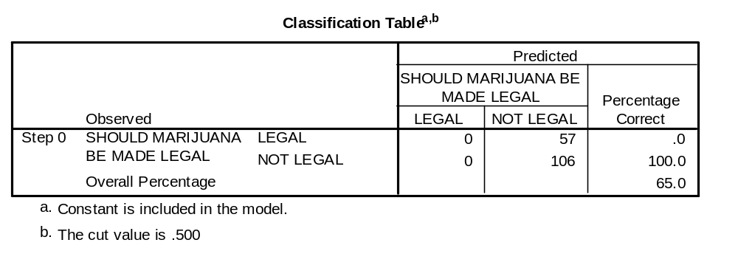
CLASSIFICATION USING THE LOGISTIC REGRESSION MODEL: by chance accuracy rate
SW388R7
Data Analysis & Computers II
Slide <number>
The independent variables could be characterized as useful predictors distinguishing survey respondents who have been less supportive that the use of marijuana should be made legal from survey respondents who have been more supportive that the use of marijuana should be made legal if the classification accuracy rate was substantially higher than the accuracy attainable by chance alone. Operationally, the classification accuracy rate should be 25% or more higher than the proportional by chance accuracy rate.
The proportional by chance accuracy rate was computed by calculating the proportion of cases for each group based on the number of cases in each group in the classification table at Step 0, and then squaring and summing the proportion of cases in each group (0.350² + 0.650² = 0.545).

Slide 59
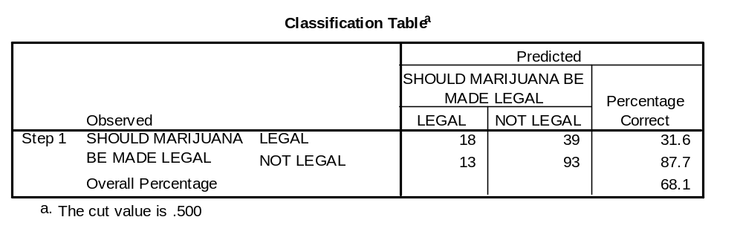
CLASSIFICATION USING THE LOGISTIC REGRESSION MODEL: criteria for classification accuracy
SW388R7
Data Analysis & Computers II
Slide <number>
The accuracy rate computed by SPSS was 68.1% which was greater than or equal to the proportional by chance accuracy criteria of 68.1% (1.25 x 54.5% = 68.1%).
The criteria for classification accuracy is satisfied.

Slide 60
Answering the question in problem 2 - 1
SW388R7
Data Analysis & Computers II
Slide <number>
In the dataset GSS2000.sav, is the following statement true, false, or an incorrect application of a statistic? Assume that there is no problem with missing data, outliers, or influential cases, and that the validation analysis will confirm the generalizability of the results. Use a level of significance of 0.05 for evaluating the statistical relationship.
After controlling for the effect of the variable "sex" [sex] on "should marijuana be made legal" [grass], the variable "general happiness" [happy] and "confidence in the executive branch of the federal government" [confed] were useful predictors for distinguishing between groups based on responses to "should marijuana be made legal" [grass]. These predictors differentiate survey respondents who have been less supportive that the use of marijuana should be made legal from survey respondents who have been more supportive that the use of marijuana should be made legal.
Survey respondents who were less happy overall were less likely to have been less supportive that the use of marijuana should be made legal. A one unit increase in general happiness decreased the odds that survey respondents have been less supportive that the use of marijuana should be made legal by 66.9%. Survey respondents who had less confidence in the executive branch of the federal government were less likely to have been less supportive that the use of marijuana should be made legal. A one unit increase in confidence in the executive branch of the federal government decreased the odds that survey respondents have been less supportive that the use of marijuana should be made legal by 42.8%.
1. True
2. True with caution
3. False
4. Inappropriate application of a statistic
We found a statistically significant overall relationship between the predictor independent variables and the dependent variable.
There was no evidence of numerical problems in the solution.
Moreover, the classification accuracy surpassed the proportional by chance accuracy criteria, supporting the utility of the model.

Slide 61
Answering the question in problem 2 - 2
SW388R7
Data Analysis & Computers II
Slide <number>
In the dataset GSS2000.sav, is the following statement true, false, or an incorrect application of a statistic? Assume that there is no problem with missing data, outliers, or influential cases, and that the validation analysis will confirm the generalizability of the results. Use a level of significance of 0.05 for evaluating the statistical relationship.
After controlling for the effect of the variable "sex" [sex] on "should marijuana be made legal" [grass], the variable "general happiness" [happy] and "confidence in the executive branch of the federal government" [confed] were useful predictors for distinguishing between groups based on responses to "should marijuana be made legal" [grass]. These predictors differentiate survey respondents who have been less supportive that the use of marijuana should be made legal from survey respondents who have been more supportive that the use of marijuana should be made legal.
Survey respondents who were less happy overall were less likely to have been less supportive that the use of marijuana should be made legal. A one unit increase in general happiness decreased the odds that survey respondents have been less supportive that the use of marijuana should be made legal by 66.9%. Survey respondents who had less confidence in the executive branch of the federal government were less likely to have been less supportive that the use of marijuana should be made legal. A one unit increase in confidence in the executive branch of the federal government decreased the odds that survey respondents have been less supportive that the use of marijuana should be made legal by 42.8%.
1. True
2. True with caution
3. False
4. Inappropriate application of a statistic
We verified that each statement about the relationship between an independent variable and the dependent variable was correct in both direction of the relationship and the change in likelihood associated with a one-unit change of the independent variable.
The answer to the question is true with caution.
A caution is added because of the inclusion of ordinal level variables.

Slide 62
Problem 3
SW388R7
Data Analysis & Computers II
Slide <number>
In the dataset GSS2000.sav, is the following statement true, false, or an incorrect application of a statistic? Assume that there is no problem with missing data, outliers, or influential cases, and that the validation analysis will confirm the generalizability of the results. Use a level of significance of 0.05 for evaluating the statistical relationship.
From the list of variables "highest academic degree" [degree], "total family income" [income98], and "satisfaction with financial situation" [satfin], the most useful predictor for distinguishing between groups based on responses to "expect u.s. in world war in 10 years" [uswary] was "total family income" [income98]. These predictors differentiate survey respondents who have been less positive that the United States would fight in another world war within the next ten years from survey respondents who have been more positive that the United States would fight in another world war within the next ten years.
The most important predictor for identifying survey respondents who have been less positive that the United States would fight in another world war within the next ten years was total family income.
Survey respondents who had higher total family incomes were more likely to have been less positive that the United States would fight in another world war within the next ten years. A one unit increase in total family income increased the odds that survey respondents have been less positive that the United States would fight in another world war within the next ten years by 10.0%.
1. True
2. True with caution
3. False
4. Inappropriate application of a statistic

Slide 63
Dissecting Problem 3 - 1
SW388R7
Data Analysis & Computers II
Slide <number>
In the dataset GSS2000.sav, is the following statement true, false, or an incorrect application of a statistic? Assume that there is no problem with missing data, outliers, or influential cases, and that the validation analysis will confirm the generalizability of the results. Use a level of significance of 0.05 for evaluating the statistical relationship.
From the list of variables "highest academic degree" [degree], "total family income" [income98], and "satisfaction with financial situation" [satfin], the most useful predictor for distinguishing between groups based on responses to "expect u.s. in world war in 10 years" [uswary] was "total family income" [income98]. These predictors differentiate survey respondents who have been less positive that the United States would fight in another world war within the next ten years from survey respondents who have been more positive that the United States would fight in another world war within the next ten years.
The most important predictor for identifying survey respondents who have been less positive that the United States would fight in another world war within the next ten years was total family income.
Survey respondents who had higher total family incomes were more likely to have been less positive that the United States would fight in another world war within the next ten years. A one unit increase in total family income increased the odds that survey respondents have been less positive that the United States would fight in another world war within the next ten years by 10.0%.
1. True
2. True with caution
3. False
4. Inappropriate application of a statistic
For these problems, we will assume that there is no problem with missing data, outliers, or influential cases, and that the validation analysis will confirm the generalizability of the results
In this problem, we are told to use 0.05 as alpha for the logistic regression.

Slide 64
Dissecting Problem 3 - 2
SW388R7
Data Analysis & Computers II
Slide <number>
The variables listed first in the problem statement are the independent variables (IVs): "highest academic degree" [degree], "total family income" [income98], and "satisfaction with financial situation" [satfin].
The variable used to define groups is the dependent variable (DV): "expect u.s. in world war in 10 years" [uswary].
In the dataset GSS2000.sav, is the following statement true, false, or an incorrect application of a statistic? Assume that there is no problem with missing data, outliers, or influential cases, and that the validation analysis will confirm the generalizability of the results. Use a level of significance of 0.05 for evaluating the statistical relationship.
From the list of variables "highest academic degree" [degree], "total family income" [income98], and "satisfaction with financial situation" [satfin], the most useful predictor for distinguishing between groups based on responses to "expect u.s. in world war in 10 years" [uswary] was "total family income" [income98]. These predictors differentiate survey respondents who have been less positive that the United States would fight in another world war within the next ten years from survey respondents who have been more positive that the United States would fight in another world war within the next ten years.
The most important predictor for identifying survey respondents who have been less positive that the United States would fight in another world war within the next ten years was total family income.
Survey respondents who had higher total family incomes were more likely to have been less positive that the United States would fight in another world war within the next ten years. A one unit increase in total family income increased the odds that survey respondents have been less positive that the United States would fight in another world war within the next ten years by 10.0%.
Since the problem identifies the most useful of important predictor, we do a stepwise logistic regression.

Slide 65
Dissecting Problem 3 - 3
SW388R7
Data Analysis & Computers II
Slide <number>
In the dataset GSS2000.sav, is the following statement true, false, or an incorrect application of a statistic? Assume that there is no problem with missing data, outliers, or influential cases, and that the validation analysis will confirm the generalizability of the results. Use a level of significance of 0.05 for evaluating the statistical relationship.
From the list of variables "highest academic degree" [degree], "total family income" [income98], and "satisfaction with financial situation" [satfin], the most useful predictor for distinguishing between groups based on responses to "expect u.s. in world war in 10 years" [uswary] was "total family income" [income98]. These predictors differentiate survey respondents who have been less positive that the United States would fight in another world war within the next ten years from survey respondents who have been more positive that the United States would fight in another world war within the next ten years.
The most important predictor for identifying survey respondents who have been less positive that the United States would fight in another world war within the next ten years was total family income.
Survey respondents who had higher total family incomes were more likely to have been less positive that the United States would fight in another world war within the next ten years. A one unit increase in total family income increased the odds that survey respondents have been less positive that the United States would fight in another world war within the next ten years by 10.0%.
SPSS logistic regression models the relationship by computing the changes in the likelihood of falling in the category of the dependent variable which had the highest numerical code.
The responses to “expect u.s. in world war in 10 years” were coded: 1= Yes and 2 = No.
The SPSS output will model the changes in the likelihood of being less positive that the United States would fight in another world war within the next ten years.

Slide 66
Dissecting Problem 3 - 4
SW388R7
Data Analysis & Computers II
Slide <number>
In the dataset GSS2000.sav, is the following statement true, false, or an incorrect application of a statistic? Assume that there is no problem with missing data, outliers, or influential cases, and that the validation analysis will confirm the generalizability of the results. Use a level of significance of 0.05 for evaluating the statistical relationship.
From the list of variables "highest academic degree" [degree], "total family income" [income98], and "satisfaction with financial situation" [satfin], the most useful predictor for distinguishing between groups based on responses to "expect u.s. in world war in 10 years" [uswary] was "total family income" [income98]. These predictors differentiate survey respondents who have been less positive that the United States would fight in another world war within the next ten years from survey respondents who have been more positive that the United States would fight in another world war within the next ten years.
The most important predictor for identifying survey respondents who have been less positive that the United States would fight in another world war within the next ten years was total family income.
Survey respondents who had higher total family incomes were more likely to have been less positive that the United States would fight in another world war within the next ten years. A one unit increase in total family income increased the odds that survey respondents have been less positive that the United States would fight in another world war within the next ten years by 10.0%.
The statements of the specific relationships between independent variables and the dependent variable are all phrased in terms of impact on being less positive that the United States would fight in another world war within the next ten years.

Slide 67
Dissecting Problem 3 - 5
SW388R7
Data Analysis & Computers II
Slide <number>
From the list of variables "highest academic degree" [degree], "total family income" [income98], and "satisfaction with financial situation" [satfin], the most useful predictor for distinguishing between groups based on responses to "expect u.s. in world war in 10 years" [uswary] was "total family income" [income98]. These predictors differentiate survey respondents who have been less positive that the United States would fight in another world war within the next ten years from survey respondents who have been more positive that the United States would fight in another world war within the next ten years.
The most important predictor for identifying survey respondents who have been less positive that the United States would fight in another world war within the next ten years was total family income.
Survey respondents who had higher total family incomes were more likely to have been less positive that the United States would fight in another world war within the next ten years. A one unit increase in total family income increased the odds that survey respondents have been less positive that the United States would fight in another world war within the next ten years by 10.0%.
1. True
2. True with caution
3. False
4. Inappropriate application of a statistic
The specific relationships for the independent variables listed in the problem indicate the direction of the relationship, increasing or decreasing the likelihood of falling in the modeled group, and the amount of change associated with a one-unit change in the independent variable.
In order for the logistic regression question to be true, the relationship between the predictors selected for inclusion and the dependent variable must be statistically significant, there must be no evidence of a flawed numerical analysis, the classification accuracy rate must be substantially better than could be obtained by chance alone, and the order of entry and each significant relationship must be interpreted correctly.

Slide 68
LEVEL OF MEASUREMENT - 1
SW388R7
Data Analysis & Computers II
Slide <number>
In the dataset GSS2000.sav, is the following statement true, false, or an incorrect application of a statistic? Assume that there is no problem with missing data, outliers, or influential cases, and that the validation analysis will confirm the generalizability of the results. Use a level of significance of 0.05 for evaluating the statistical relationship.
From the list of variables "highest academic degree" [degree], "total family income" [income98], and "satisfaction with financial situation" [satfin], the most useful predictor for distinguishing between groups based on responses to "expect u.s. in world war in 10 years" [uswary] was "total family income" [income98]. These predictors differentiate survey respondents who have been less positive that the United States would fight in another world war within the next ten years from survey respondents who have been more positive that the United States would fight in another world war within the next ten years.
The most important predictor for identifying survey respondents who have been less positive that the United States would fight in another world war within the next ten years was total family income.
Survey respondents who had higher total family incomes were more likely to have been less positive that the United States would fight in another world war within the next ten years. A one unit increase in total family income increased the odds that survey respondents have been less positive that the United States would fight in another world war within the next ten years by 10.0%.
1. True
2. True with caution
3. False
4. Inappropriate application of a statistic
Logistic regression analysis requires that the dependent variable be dichotomous and the independent variables be metric or dichotomous. "Expect u.s. in world war in 10 years" [uswary] is a dichotomous variable, which satisfies the level of measurement requirement for the dependent variable.
It contains two categories:
survey respondents who have been less positive that the United States would fight in another world war within the next ten years
survey respondents who have been more positive that the United States would fight in another world war within the next ten years.

Slide 69
LEVEL OF MEASUREMENT - 2
SW388R7
Data Analysis & Computers II
Slide <number>
"Highest academic degree" [degree], "total family income" [income98], and "satisfaction with financial situation" [satfin] are ordinal level variables. If we follow the convention of treating ordinal level variables as metric variables, the level of measurement requirement for logistic regression analysis is satisfied. Since some data analysts do not agree with this convention, a note of caution should be included in our interpretation.
In the dataset GSS2000.sav, is the following statement true, false, or an incorrect application of a statistic? Assume that there is no problem with missing data, outliers, or influential cases, and that the validation analysis will confirm the generalizability of the results. Use a level of significance of 0.05 for evaluating the statistical relationship.
From the list of variables "highest academic degree" [degree], "total family income" [income98], and "satisfaction with financial situation" [satfin], the most useful predictor for distinguishing between groups based on responses to "expect u.s. in world war in 10 years" [uswary] was "total family income" [income98]. These predictors differentiate survey respondents who have been less positive that the United States would fight in another world war within the next ten years from survey respondents who have been more positive that the United States would fight in another world war within the next ten years.
The most important predictor for identifying survey respondents who have been less positive that the United States would fight in another world war within the next ten years was total family income.
Survey respondents who had higher total family incomes were more likely to have been less positive that the United States would fight in another world war within the next ten years. A one unit increase in total family income increased the odds that survey respondents have been less positive that the United States would fight in another world war within the next ten years by 10.0%.

Slide 70
Request stepwise logistic regression
SW388R7
Data Analysis & Computers II
Slide <number>
Select the Regression | Binary Logistic… command from the Analyze menu.

Slide 71
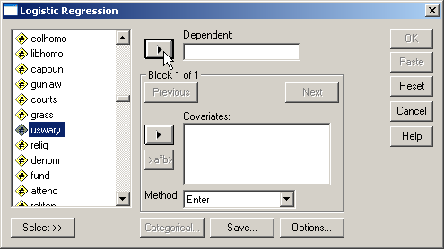
Selecting the dependent variable
SW388R7
Data Analysis & Computers II
Slide <number>
First, highlight the dependent variable uswary in the list of variables.
Second, click on the right arrow button to move the dependent variable to the Dependent text box.

Slide 72
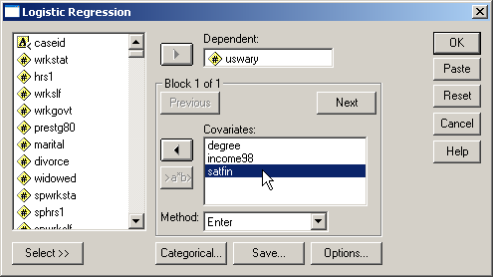
Adding the independent variables
SW388R7
Data Analysis & Computers II
Slide <number>
First, move the predictors to the Covariates list box.

Slide 73
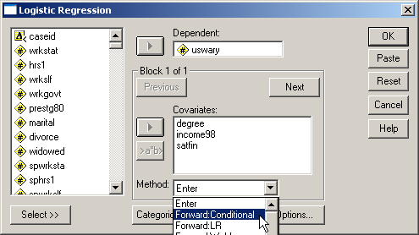
Specifying the method for including variables
SW388R7
Data Analysis & Computers II
Slide <number>
In our stepwise logistic regression, we specify the Forward Conditional method for adding variables.

Slide 74
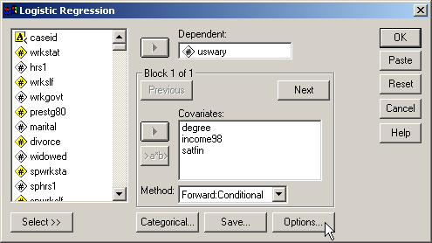
Adding options to the output
SW388R7
Data Analysis & Computers II
Slide <number>
To add a summary of steps at the end of the analysis and specifications for stepwise method, click on the Options… button.

Slide 75
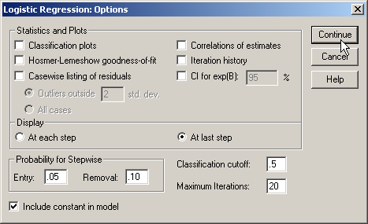
Including a summary of steps
SW388R7
Data Analysis & Computers II
Slide <number>
To obtain a summary of the steps on which variables were added or removed from the analysis, mark the option button At last step in the Display panel.

Slide 76
Specifications for stepwise method
SW388R7
Data Analysis & Computers II
Slide <number>
Click on the Continue button to close the dialog box.
We can change the criteria for adding and removing variables from the analysis by changing the probability for entry and removal. We will use the default level of significance of 0.05 for entry and 0.10 for removal.

Slide 77
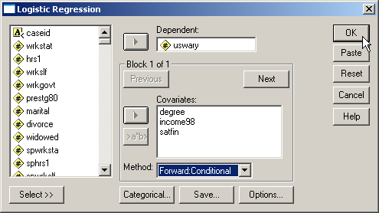
Completing the logistic regression request
SW388R7
Data Analysis & Computers II
Slide <number>
Click on the OK button to request the output for the logistic regression.

Slide 78

Sample size – ratio of cases to variables
SW388R7
Data Analysis & Computers II
Slide <number>
The minimum ratio of valid cases to independent variables for stepwise logistic regression is 10 to 1, with a preferred ratio of 50 to 1. In this analysis, there are 136 valid cases and 3 independent variables. The ratio of cases to independent variables is 45.33 to 1, which satisfies the minimum requirement. However, the ratio of 45.33 to 1 does not satisfy the preferred ratio of 50 to 1. A caution should be added to the interpretation of the analysis and a split sample validation should be conducted.

Slide 79
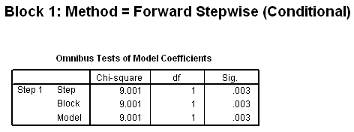
OVERALL RELATIONSHIP BETWEEN INDEPENDENT AND DEPENDENT VARIABLES
SW388R7
Data Analysis & Computers II
Slide <number>
The presence of a relationship between the dependent variable and combination of independent variables is based on the statistical significance of the model chi-square.
In this analysis, the probability of the model chi-square (9.001) was 0.003, less than or equal to the level of significance of 0.05. The null hypothesis that there is no difference between the model with only a constant and the model with independent variables was rejected. The existence of a relationship between the independent variables and the dependent variable was supported.

Slide 80
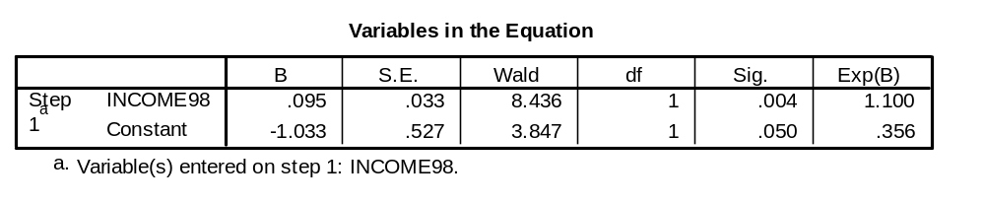
NUMERICAL PROBLEMS
SW388R7
Data Analysis & Computers II
Slide <number>
Multicollinearity in the logistic regression solution is detected by examining the standard errors for the b coefficients. A standard error larger than 2.0 indicates numerical problems, such as multicollinearity among the independent variables, zero cells for a dummy-coded independent variable because all of the subjects have the same value for the variable, and 'complete separation' whereby the two groups in the dependent event variable can be perfectly separated by scores on one of the independent variables. Analyses that indicate numerical problems should not be interpreted.
None of the independent variables in this analysis had a standard error larger than 2.0. (The check for standard errors larger than 2.0 does not include the standard error for the Constant.)

Slide 81
RELATIONSHIP OF INDIVIDUAL INDEPENDENT VARIABLES TO DEPENDENT VARIABLE
SW388R7
Data Analysis & Computers II
Slide <number>
The probability of the Wald statistic for the variable total family income was 0.004, less than or equal to the level of significance of 0.05. The null hypothesis that the b coefficient for total family income was equal to zero was rejected. This supports the relationship that "survey respondents who had higher total family incomes were more likely to have been less positive that the United States would fight in another world war within the next ten years." Total family income is an ordinal variable that is coded so that higher numeric values are associated with survey respondents who had higher total family incomes.
The value of Exp(B) was 1.100 which implies that a one unit increase in total family income increased the odds that survey respondents have been less positive that the United States would fight in another world war within the next ten years by 10.0%.

Slide 82
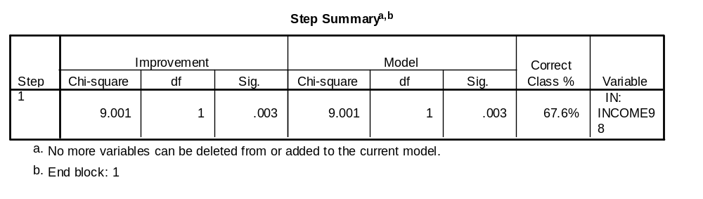
IMPORTANCE OF INDIVIDUAL INDEPENDENT VARIABLES TO DEPENDENT VARIABLE
SW388R7
Data Analysis & Computers II
Slide <number>
The order of importance is based on the entry order of the variables included in the stepwise logistic regression. The entry order is summarized in the Step Summary table, in which we see which variable was added or removed at each step.
The most important predictor for identifying survey respondents who have been less positive that the United States would fight in another world war within the next ten years was total family income [INCOME98].
The importance of the predictors stated in the problem is correct.

Slide 83
CLASSIFICATION USING THE LOGISTIC REGRESSION MODEL: by chance accuracy rate
SW388R7
Data Analysis & Computers II
Slide <number>
The independent variables could be characterized as useful predictors distinguishing survey respondents who have been less positive that the United States would fight in another world war within the next ten years from survey respondents who have been more positive that the United States would fight in another world war within the next ten years if the classification accuracy rate was substantially higher than the accuracy attainable by chance alone. Operationally, the classification accuracy rate should be 25% or more higher than the proportional by chance accuracy rate.
The proportional by chance accuracy rate was computed by calculating the proportion of cases for each group based on the number of cases in each group in the classification table at Step 0, and then squaring and summing the proportion of cases in each group (0.397² + 0.603² = 0.521).

Slide 84
CLASSIFICATION USING THE LOGISTIC REGRESSION MODEL: criteria for classification accuracy
SW388R7
Data Analysis & Computers II
Slide <number>
The accuracy rate computed by SPSS was 67.6% which was greater than or equal to the proportional by chance accuracy criteria of 65.2% (1.25 x 52.1% = 65.2%).
The criteria for classification accuracy is satisfied.

Slide 85
Answering the question in problem 3 - 1
SW388R7
Data Analysis & Computers II
Slide <number>
In the dataset GSS2000.sav, is the following statement true, false, or an incorrect application of a statistic? Assume that there is no problem with missing data, outliers, or influential cases, and that the validation analysis will confirm the generalizability of the results. Use a level of significance of 0.05 for evaluating the statistical relationship.
From the list of variables "highest academic degree" [degree], "total family income" [income98], and "satisfaction with financial situation" [satfin], the most useful predictor for distinguishing between groups based on responses to "expect u.s. in world war in 10 years" [uswary] was "total family income" [income98]. These predictors differentiate survey respondents who have been less positive that the United States would fight in another world war within the next ten years from survey respondents who have been more positive that the United States would fight in another world war within the next ten years.
The most important predictor for identifying survey respondents who have been less positive that the United States would fight in another world war within the next ten years was total family income.
Survey respondents who had higher total family incomes were more likely to have been less positive that the United States would fight in another world war within the next ten years. A one unit increase in total family income increased the odds that survey respondents have been less positive that the United States would fight in another world war within the next ten years by 10.0%.
1. True
2. True with caution
3. False
4. Inappropriate application of a statistic
We found a statistically significant overall relationship between the predictor independent variables and the dependent variable.
There was no evidence of numerical problems in the solution.
Moreover, the classification accuracy surpassed the proportional by chance accuracy criteria, supporting the utility of the model.

Slide 86
Answering the question in problem 3 - 2
SW388R7
Data Analysis & Computers II
Slide <number>
In the dataset GSS2000.sav, is the following statement true, false, or an incorrect application of a statistic? Assume that there is no problem with missing data, outliers, or influential cases, and that the validation analysis will confirm the generalizability of the results. Use a level of significance of 0.05 for evaluating the statistical relationship.
From the list of variables "highest academic degree" [degree], "total family income" [income98], and "satisfaction with financial situation" [satfin], the most useful predictor for distinguishing between groups based on responses to "expect u.s. in world war in 10 years" [uswary] was "total family income" [income98]. These predictors differentiate survey respondents who have been less positive that the United States would fight in another world war within the next ten years from survey respondents who have been more positive that the United States would fight in another world war within the next ten years.
The most important predictor for identifying survey respondents who have been less positive that the United States would fight in another world war within the next ten years was total family income.
Survey respondents who had higher total family incomes were more likely to have been less positive that the United States would fight in another world war within the next ten years. A one unit increase in total family income increased the odds that survey respondents have been less positive that the United States would fight in another world war within the next ten years by 10.0%.
1. True
2. True with caution
3. False
4. Inappropriate application of a statistic
We verified that each statement about the relationship between an independent variable and the dependent variable was correct in both direction of the relationship and the change in likelihood associated with a one-unit change of the independent variable.
We also verified the order of importance for the independent variables included in the stepwise analysis.
The answer to the question is true with caution.
A caution is added to the findings because of the inclusion of ordinal level independent variables. A caution is added to the findings because of the preferred sample size is not met.

Slide 87
Steps in binary logistic regression: level of measurement and initial sample size
SW388R7
Data Analysis & Computers II
Slide <number>
The following is a guide to the decision process for answering
problems about the basic relationships in logistic regression:
Dependent dichotomous?
Independent variables metric or dichotomous?
No
Inappropriate application of a statistic
Yes
Ratio of cases to independent variables at least 10 to 1?
No
Inappropriate application of a statistic
Yes
Yes
Run logistic regression, using method for including variables identified in the research question.

Slide 88
Steps in logistic regression: overall relationship and numerical problems
SW388R7
Data Analysis & Computers II
Slide <number>
Hierarchical method of entry used to include independent variables?
No
Yes
Presence of relationship confirmed by test of model chi-square?
Presence of relationship confirmed by test of block chi-square?
No
No
False
Yes
Yes
False
Standard errors of coefficients indicate presence of numerical problems (s.e. > 2.0)?
Yes
False
No

Slide 89
Steps in logistic regression: relationships between IV's and DV
SW388R7
Data Analysis & Computers II
Slide <number>
Stepwise method of entry used to include independent variables?
Yes
No
Entry order of variables interpreted correctly?
No
Yes
False
Relationships between individual IVs and DV groups interpreted correctly?
No
False
Yes

Slide 90
Steps in logistic regression: classification accuracy and adding cautions
SW388R7
Data Analysis & Computers II
Slide <number>
Overall accuracy rate is 25% > than proportional by chance accuracy rate?
No
False
Yes
Yes
Satisfies preferred ratio of cases to IV's of 20 to 1
(50 to 1 for stepwise)
No
True with caution
Yes
Yes
One or more IV's are ordinal level variables?
Yes
True with caution
No
True

